Slide 1
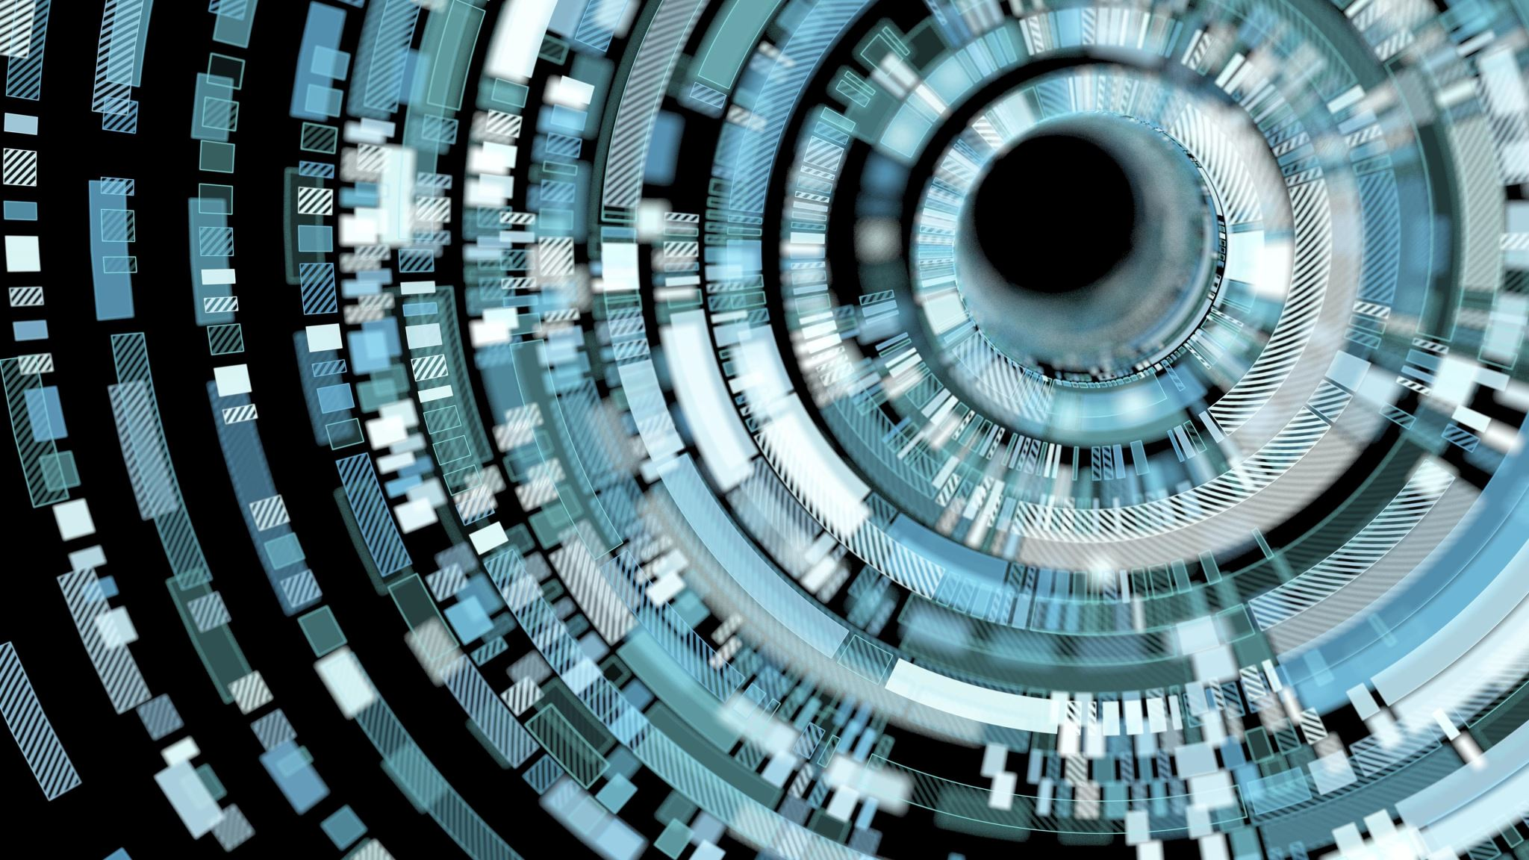
Optical Character Recognition for Kazakh Language
Magzhan Omirtay
Nazarbay Nursultan

Slide 2
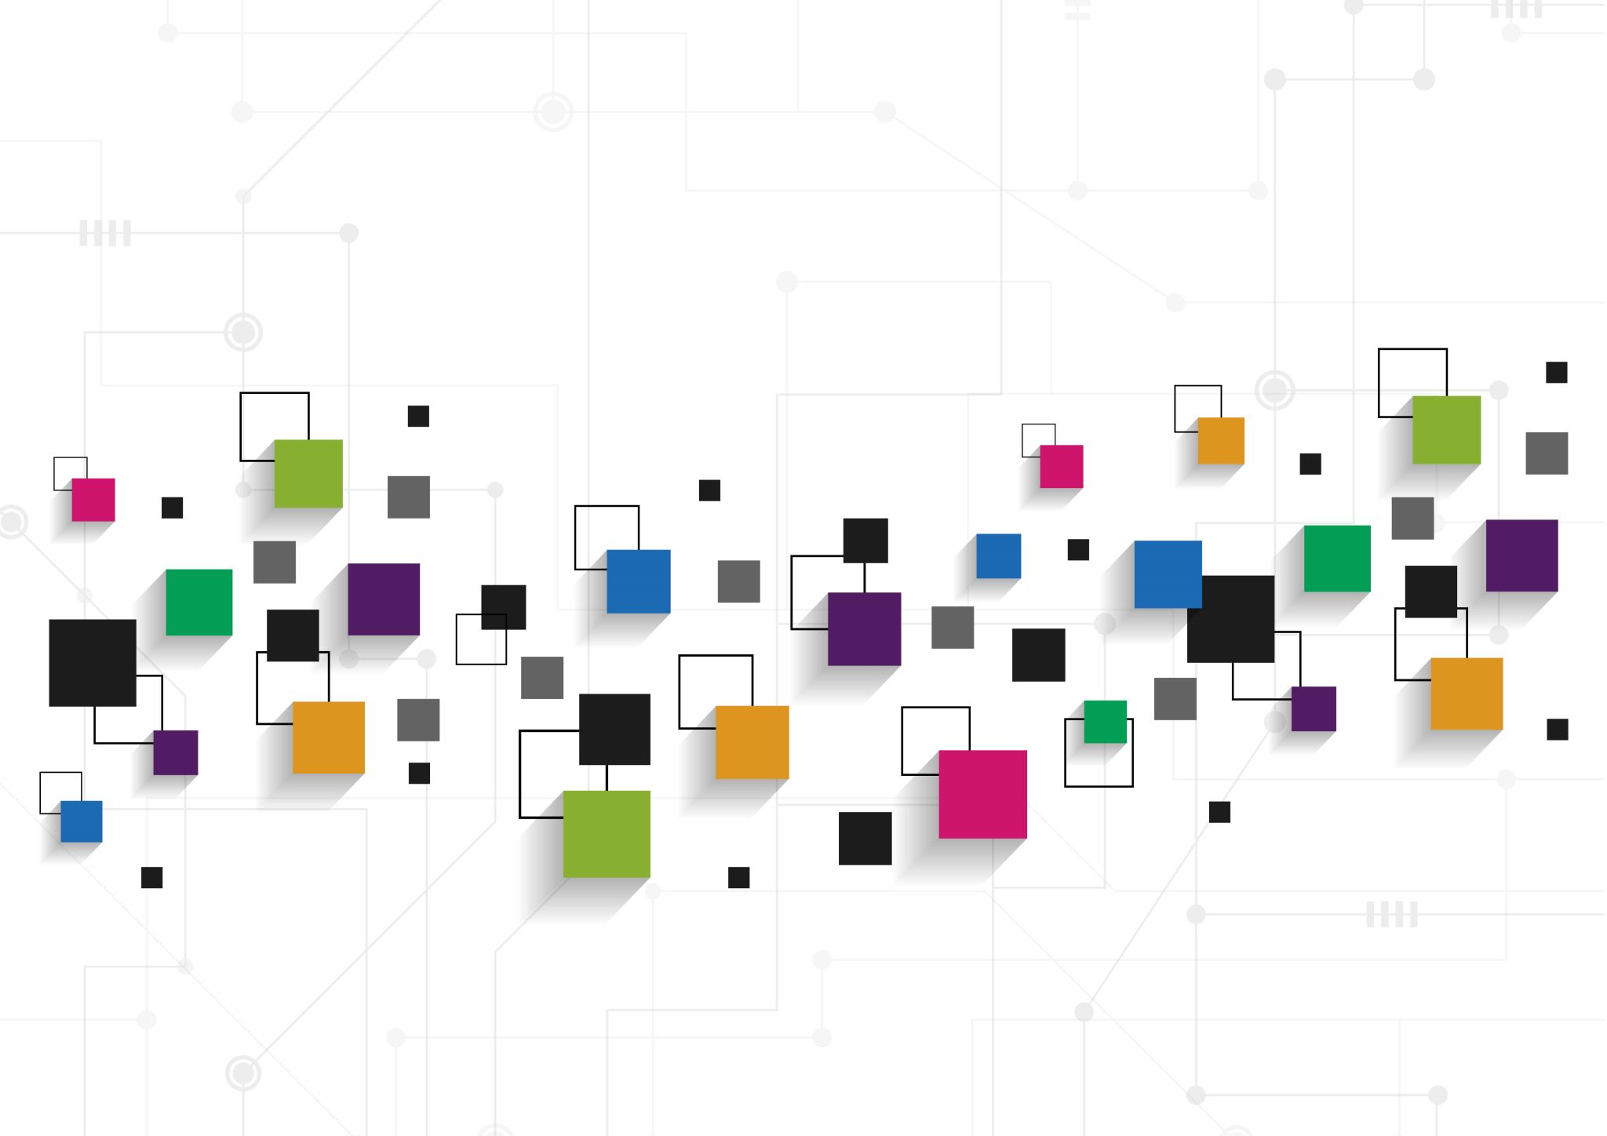
Abstract
Optical text recognition has become the most popular application of artificial intelligence techniques in human life. It is used in video and security applications, multimedia libraries, accounting, cartography, and more. All modern OCR systems are able to detect and recognize textual fragments if the input data is of good quality.

Slide 3
Originality
1. No one has researched OCR for the Kazakh language before
2. We generated dataset of Kazakh letters for training
3. We trained and tested network for OCR

Slide 4
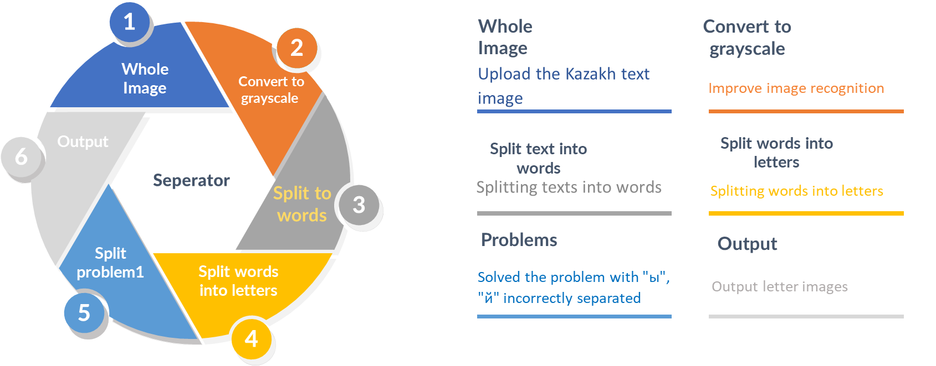
Image text preprocessing
Notes:
To solve this problem, we have generated data by writing a python script for obtaining Kazakh letters and saved them as a given letter. The script receives a scanned or photographed Kazakh text using PIL and defines words using the pytesseract library. Initially, we tried to get the coordinates of the letters using the pytesseract itself, but it does not show the correct coordinates, although it recognizes the words correctly. For our script to work correctly, we decided to use cv2 library and processed our image with a threshold function. Then we found letter contours using the findContours function, but the contour does not understand the letters and selects all objects in the images.
While processing our images, we ran into a problem with the letters "ы"and "й". Because our script split them into two parts and considered them to be different letters as in the Picture I (b). To solve this problem, we merged two adjacent images where these letters met. For this, additional functions were created: horizontal union for "ы“ and vertical union for "й". Consequently, script separates the words into letters for every 42 Kazakh letters. Further we saved them as a separate image as in the Picture I (c). and this process occurred until we collect enough data for data augmentation. After this process, we increase the amount of data to improve model accuracy.

Slide 5
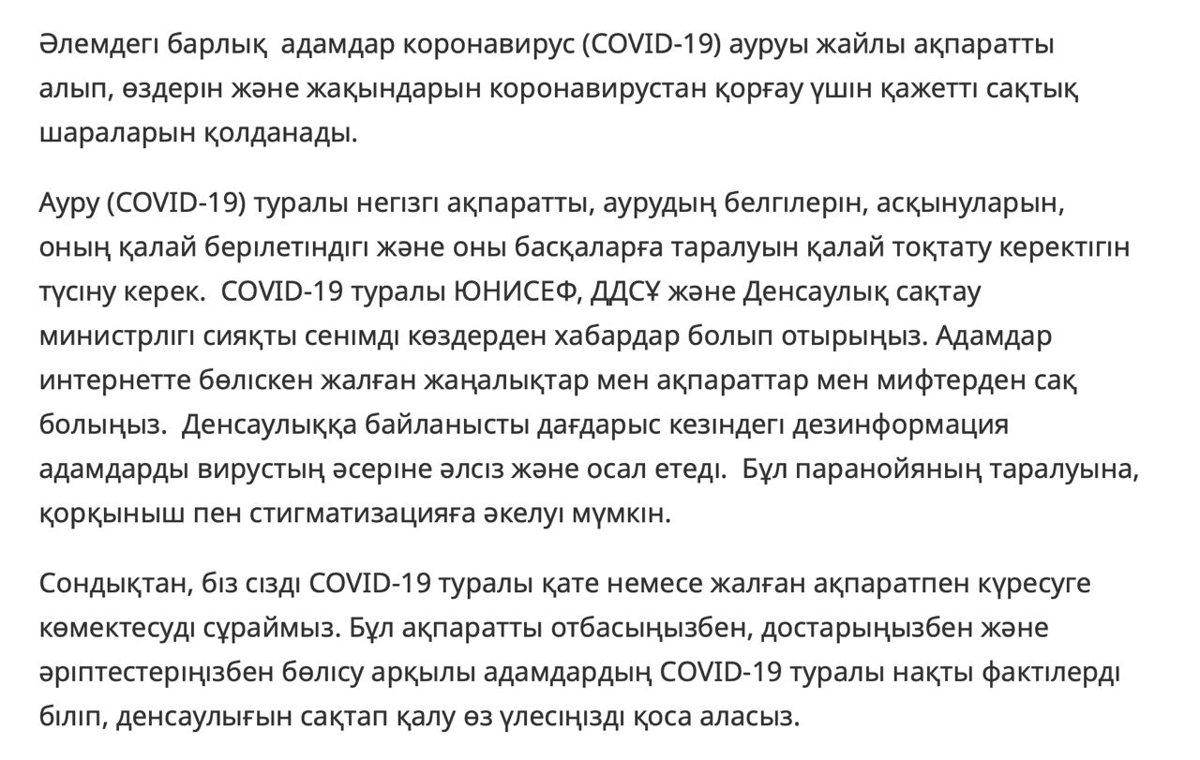
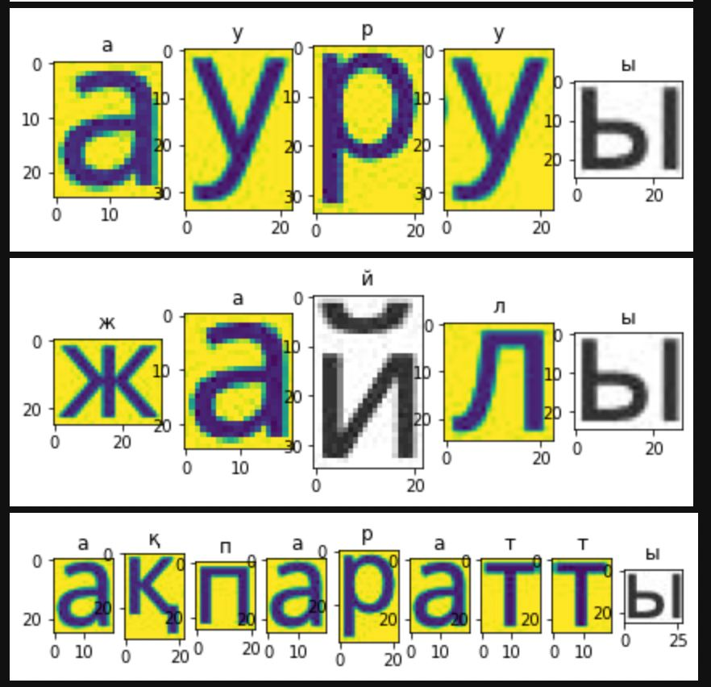
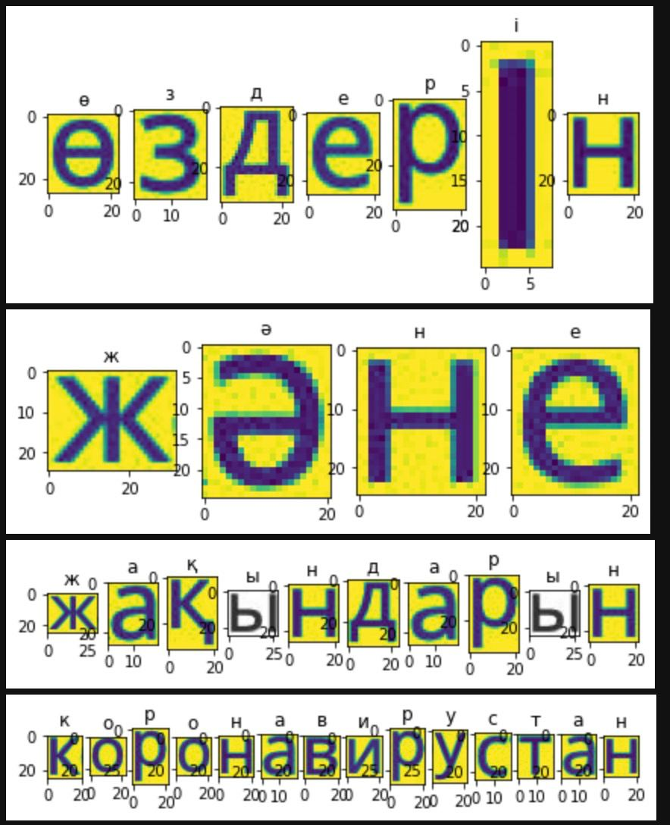
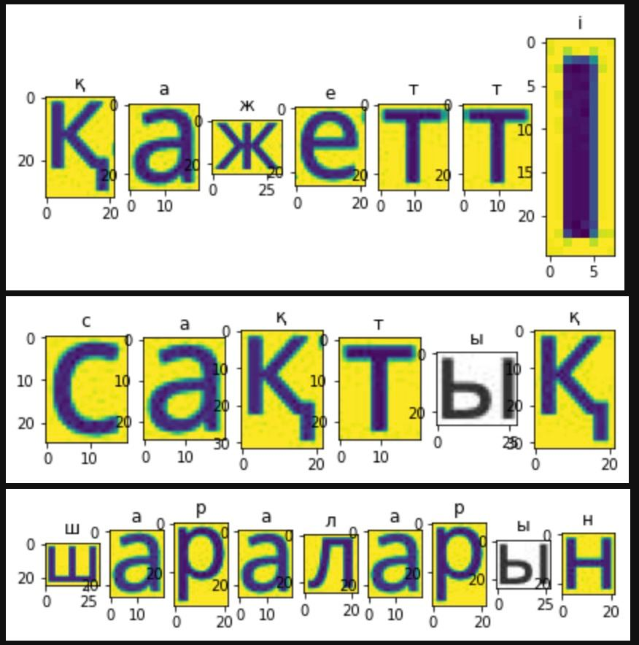
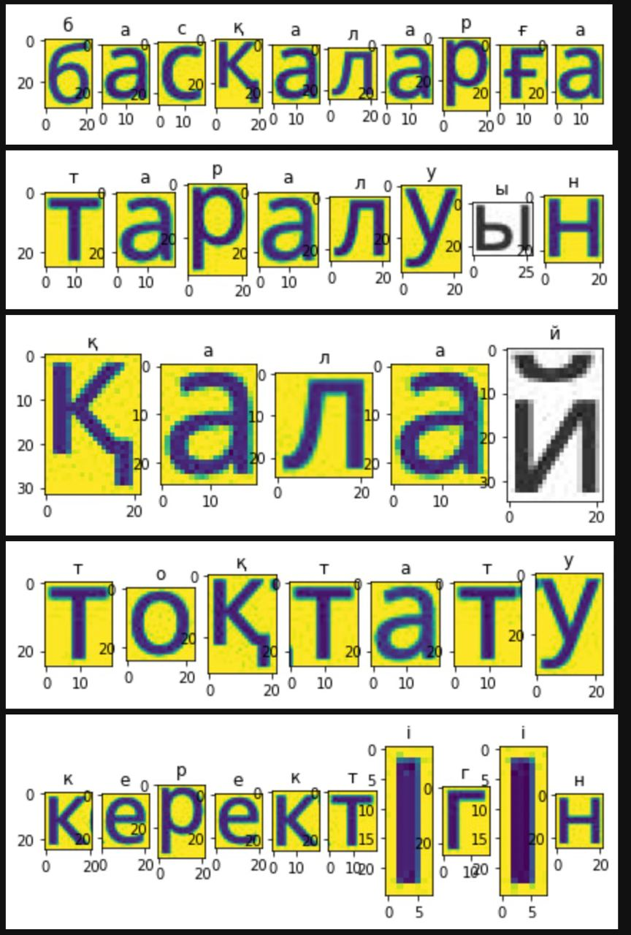
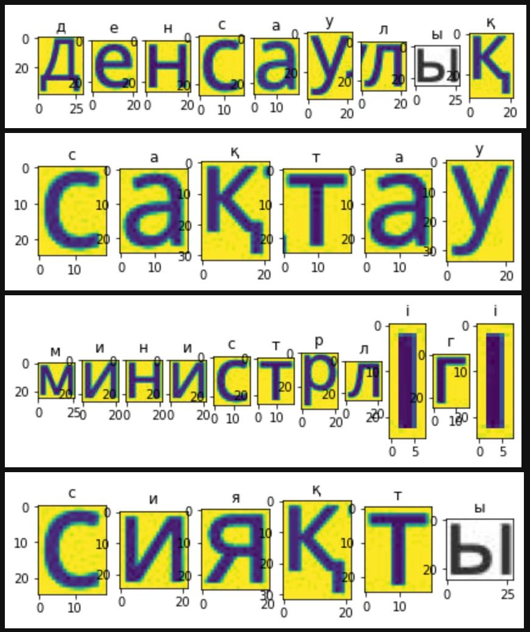
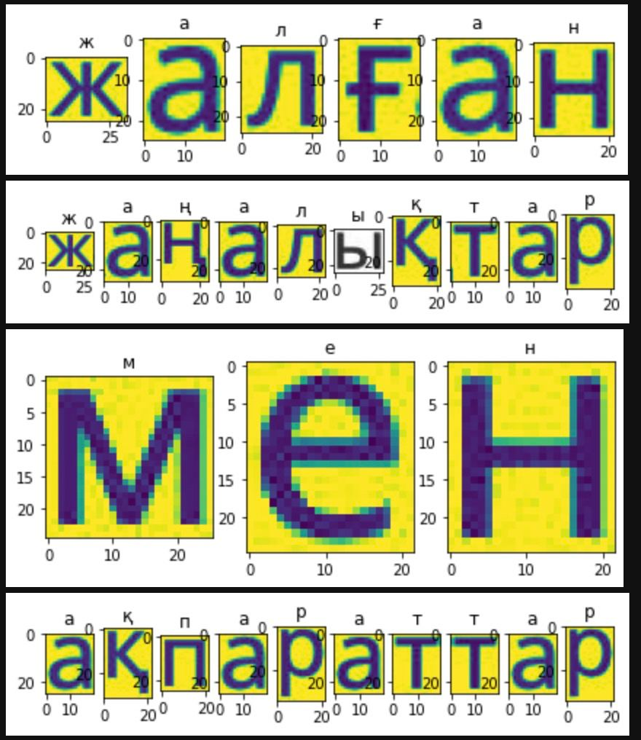
Image text preprocessing
Demo from Jupyter Notebook

Slide 6
Data Generation
Data augmentation: a technique to increase the diversity of the training set by applying random (but realistic) transformations.
Augmentation with ImageDataGenerator
Albumentations Augmentations
imgaug Based Augmentations
TensorFlow-Based Augmentations
Notes:
To get more data, we needed to make minor alterations to our existing dataset. Minor changes such as flips or translations or rotations. For this we have used data augmentation: a technique to increase the diversity of the training set by applying random (but realistic) transformations. Applying these small amounts of variations on the original image does not change its target class but only provides a new perspective of capturing the object in real life. It is quite often used for building deep learning models. In our work we used several techniques of data augmentation such as Keras ImageDataGenerator, Albumentations Augmentations, ‘imgaug‘ Based Augmentations, TensorFlow-Based Augmentations Keras ImageDataGenerator 1 class provides a quick and easy way to augment the images. It provides a host of different augmentation techniques like standardization, rotation, shifts, flips, brightness change, and many more. However, the main benefit of using the Keras ImageDataGenerator class is that it is designed to provide real-time data augmentation. Meaning it is generating augmented images on the fly while the model is still in the training stage.

Slide 7
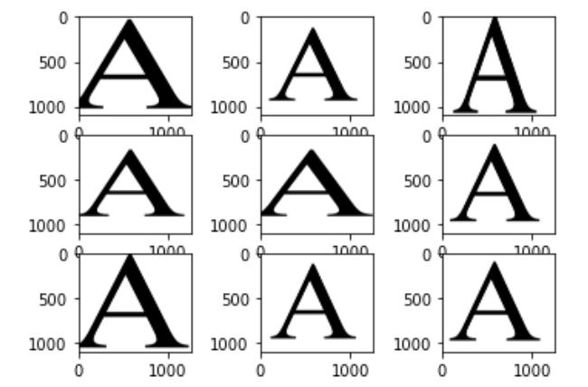
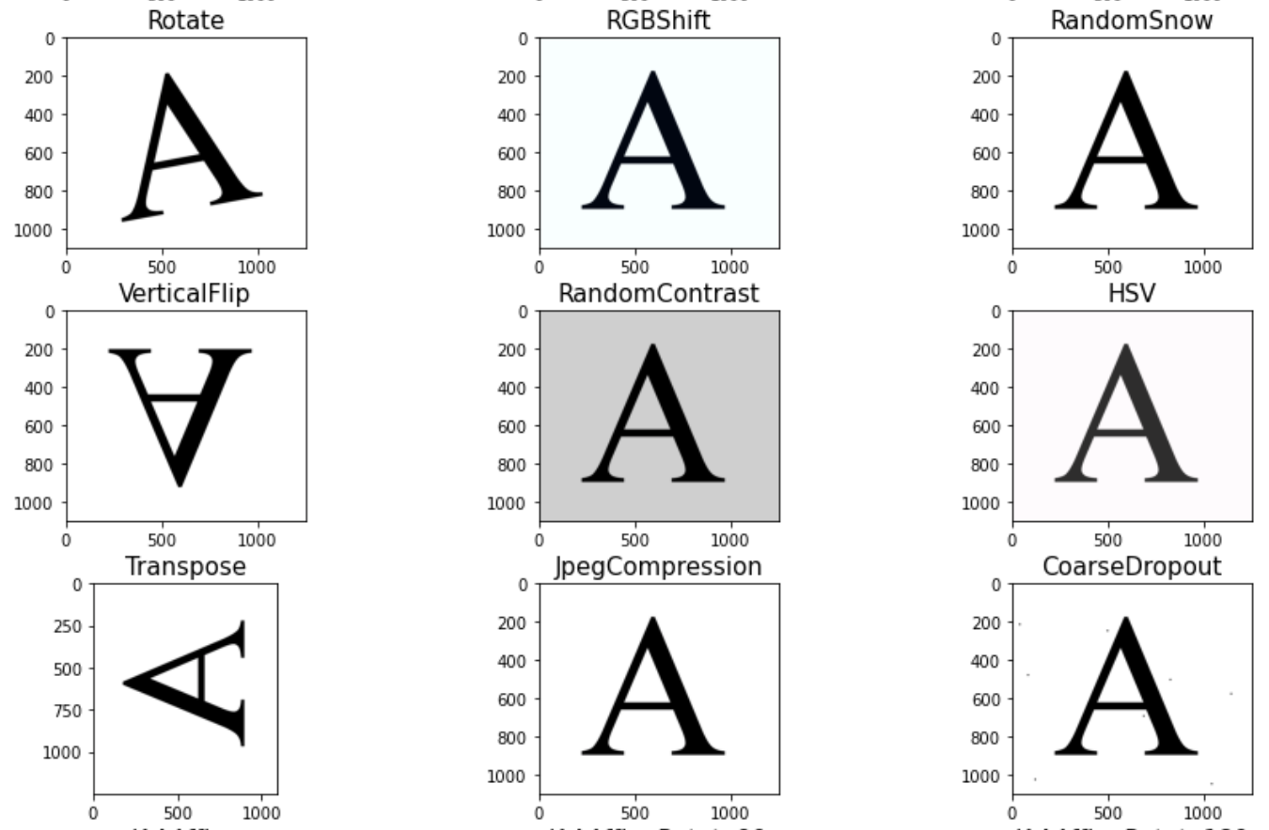
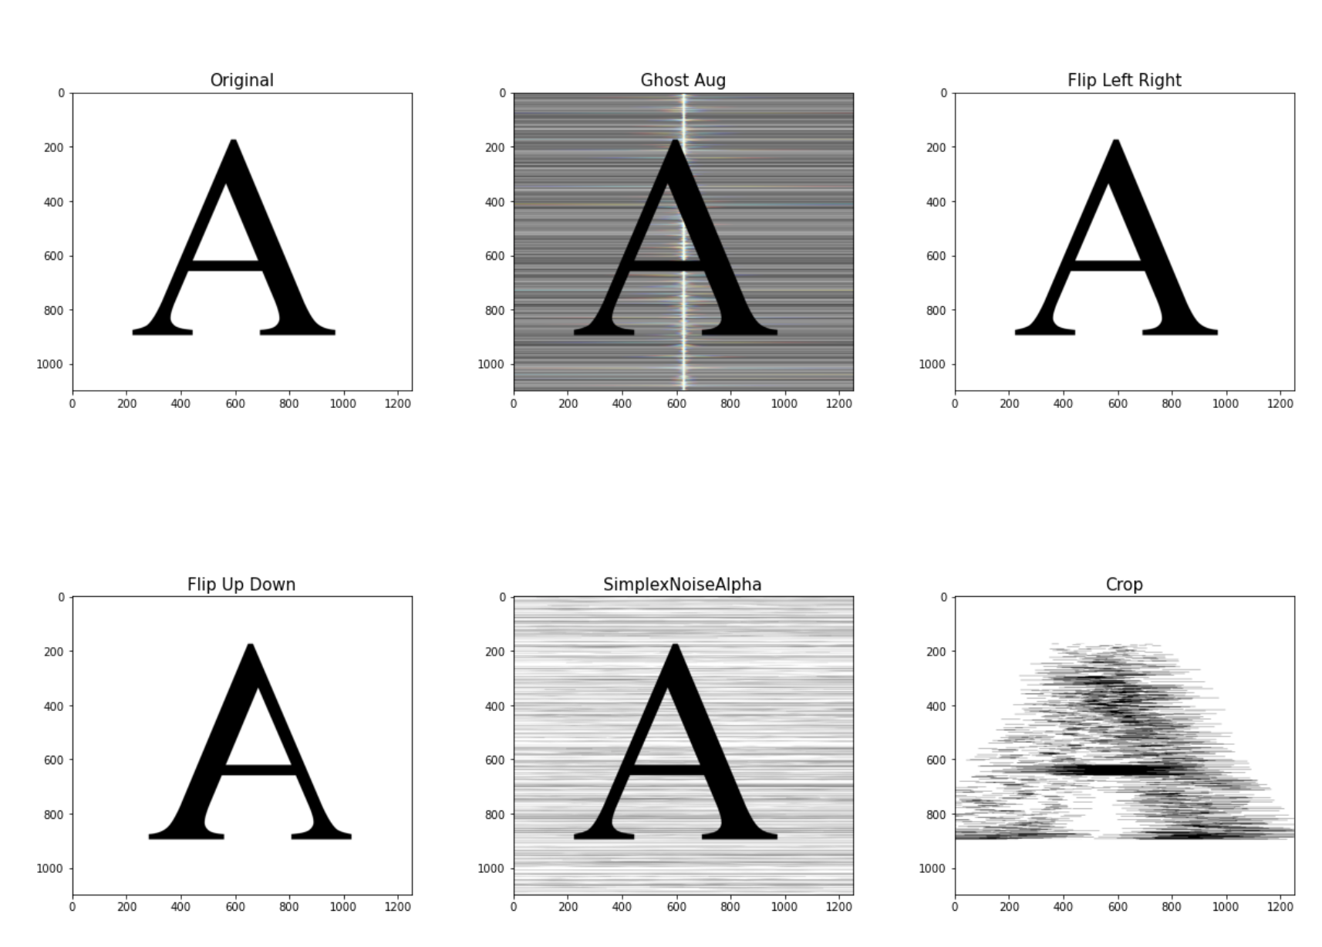
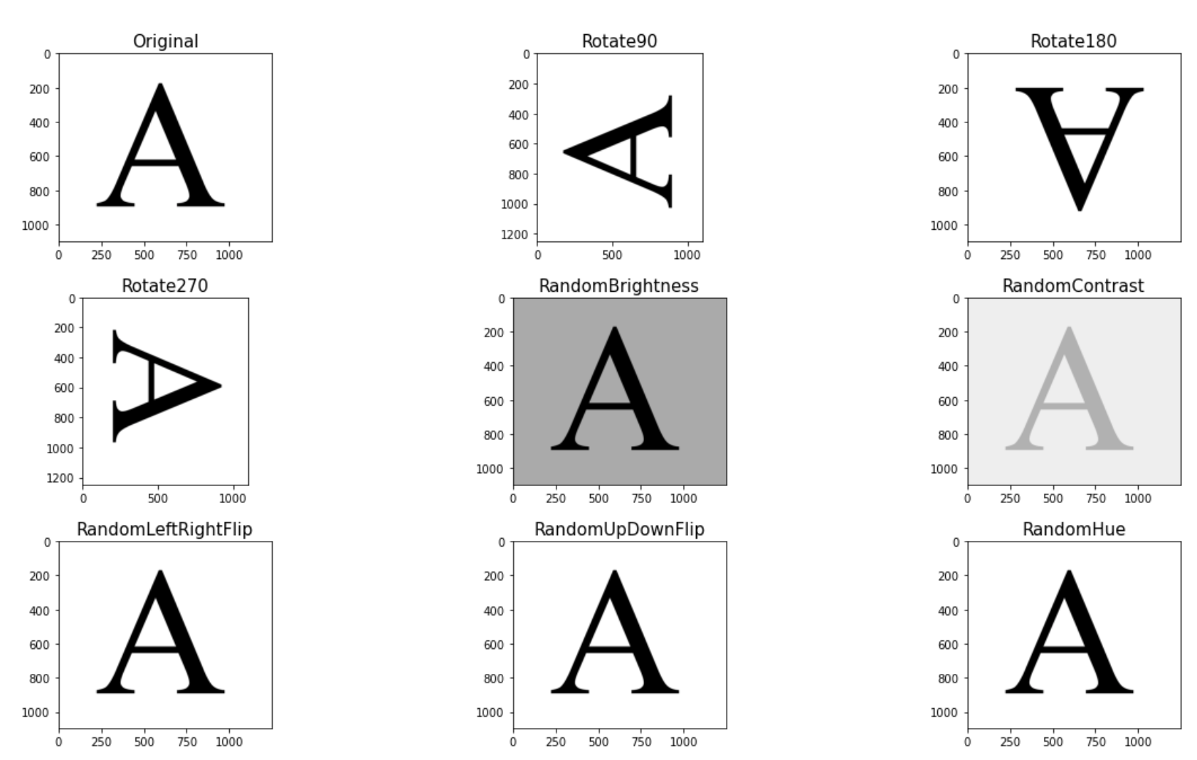
Augmentation with ImageDataGenerator
Albumentations Augmentations
TensorFlow-Based Augmentations
imgaug Based Augmentations
Notes:
Albumentations 2 is a Python library for fast and flexible image augmentations. Albumentations efficiently implements a rich variety of image transform operations that are optimized for performance, and does so while providing a concise, yet powerful image augmentation interface for different computer vision tasks, including object classification, segmentation, and detection. imgaug 3 is a library for image augmentation in machine learning experiments. It supports a wide range of augmentation techniques, allows to easily combine these and to execute them in random order or on multiple CPU cores, has a simple yet powerful stochastic interface and can not only augment images, but also keypoints/landmarks, bounding boxes, heatmaps and segmentation maps.
In TensorFlow 4 , data augmentation is accomplished using the ImageDataGenerator class. It is exceedingly simple to understand and to use. The entire dataset is looped over in each epoch, and the images in the dataset are transformed as per the options and values selected.

Slide 8
Model Training
VGG16 model
VGG16 architecture
98% accuracy
Notes:
In literature review we found different research approaches in Optical text recognition for many languages but besides the Kazakh language. Including this fact, we made a decision to create our methodology for Kazakh Language in OCR. Our idea is separate every row into words, then these words to characters. After partition steps we recognize every character in trained model on VGG16 architectures. This architecture integrated and trained on every character especially 42 kazakh letters both in uppercase and lowercase. After we trained a model, we estimated performance of our architecture on these metrics such as Accuracy, Mis-Classification, Sensitivity, Specificity, Precision, F1 Score, MCC.

Slide 9
VGG16 architecture
The Visual Geometry Group (VGG) was the runner up of ImageNet Large Scale Visual Recognition Competition(ILSVRC) in 2014.
Notes:
The Visual Geometry Group (VGG) was the runner up of ImageNet Large Scale Visual Recognition Competition (ILSVRC) in 2014. The main contribution of this model shows that the depth (i.e., number of layers) of a convolutional neural network is the critical component of high recognition or classification accuracy [8]. In this architecture, two convolutional layers are used consecutively with a rectified linear unit (ReLU) activation function followed by single max-pooling layer, several fully connected layers with ReLU and soft-max as the final layer. The 3×3 convolutional filters with stride 2 is applied for performing filtering and sub-sampling operations simultaneously in VGG-E version. There are three types of VGGNet based on the architecture. These three network contains 11, 16 and 19 layers and named as VGG-11, VGG-16 and VGG-19, respectively. The basic structure for VGG-11 architecture is shown in Fig. 3. There are five convolution layers, three max-pooling layers and three fully connected (FC) layers [8]. The configuration of VGG16 is as follows: number of convolution layers: 16, fully connected layers: 3, weights: 138 Million and Multiplication and Accumulates (MACs): 15.5G. In this architecture, the multiple convolutional layers are incorporated which is followed by a max-pooling layer. In this implementation, we have used VGG16 with less number of feature maps in each convolutional block compared to standard VFF16 model [8].

Slide 10
Notes:
This is learning curve of our model. As we can clearly seen from the diagrams that learning curves are very good trained and Training and Validation curves aren’t differ so much

Slide 11
Architecture | Metrics | Datasets
 |  | Kazakh letters images
VGG16 | Accuracy | 0.99
 | Sensitivity | 0.94
 | Specificity | 1
 | Precision | 0.96
 | F1 Score | 0.95
 | MCC | 0.98
Notes:
In order to evaluate the accuracy of the models performance we used metrics such as accuracy, sensitivity/recall, specificity, precision, F1 score, MCC. A VGG16 architecture gave us high performance results.. The overall results can be seen in the table below.

Slide 12
Conclusion
In this project Kazakh recognition system has been developed with its own Kazakh letters dataset created by data augmentation method. We generated dataset of Kazakh letters for training and trained and tested network for OCR. We hope that our work will help many people in retrieving information from text image in Kazakh language. Like students who study in Kazakh and in many cases they have to retype some text from image format to editable text. So, in the future we can make user-friendly interface application based on this work.

Slide 13

THE END
Thank you for your attention!

